Slide 1
ANALYSIS OF DIFFERENT IMAGE ENHANCEMENT TECHNIQUES FOR MRI−MODALITY
Prepared By: -
SHASHI VARDHA SAMIDI (0682803)
SHYAM JOSHI(0682020)
OLUWASEUN AJOSE (0676569)
MICHAEL AGADAH (I0682067)

Slide 2
Project Outline
Image enhancement is considered a difficult task when attempting to automate the analysis process and eliminate the human intervention. In this course project we propose different criterions for image enhancement, and attempt finding the best image according to the respective criterion.
The anatomy imaged is right thigh, using MRI. We have applied several image enhancement techniques such as: -
Histogram equalization
Gaussian High-pass filter
RGB2Gray Scale
Adaptive Histogram Equalization
And compared their results.

Slide 3
Introduction
Image enhancement is the task of applying certain transformations to an input image such as to obtain a visually more pleasant, more detailed, or less noisy output image.
During this process, one or more attributes of the image are modified. The choice of attributes and the way they are modified are specific to a given task.
Image enhancement is applied in every field where images are ought to be understood and analysed. For example, medical image analysis, analysis of images from satellites etc.,

Slide 4
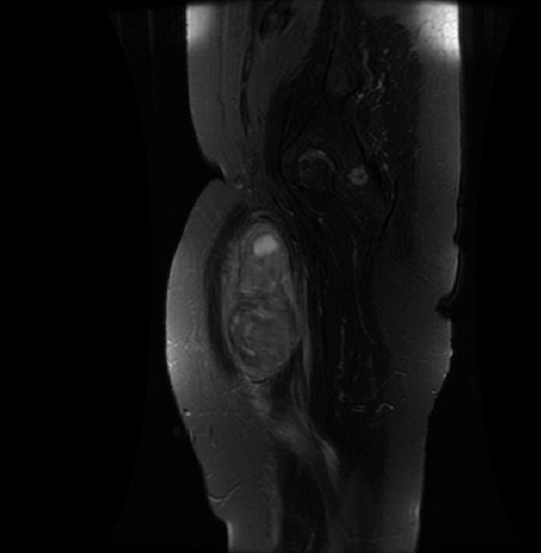
Magnetic Resonance Imaging (MRI)
Magnetic Resonance Imaging, or MRI, is a method of imaging the interior of structures noninvasively.
Figure shows the MRI of a right thigh.
We have used DICOM to obtain several attributes of the image such as pixels, bits used for encoding etc.

Slide 5
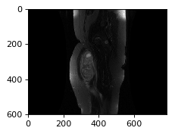
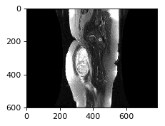
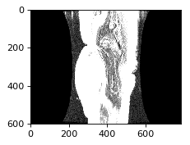
Enhancement Techniques: -
Increasing pixel intensity
We tried converting data to float using “pow” function and regenerated the image to vary intensity and exposure of the image.
As we can see in the figures below, even though intensity of the image is increasing, but we are loosing important information.

Slide 6
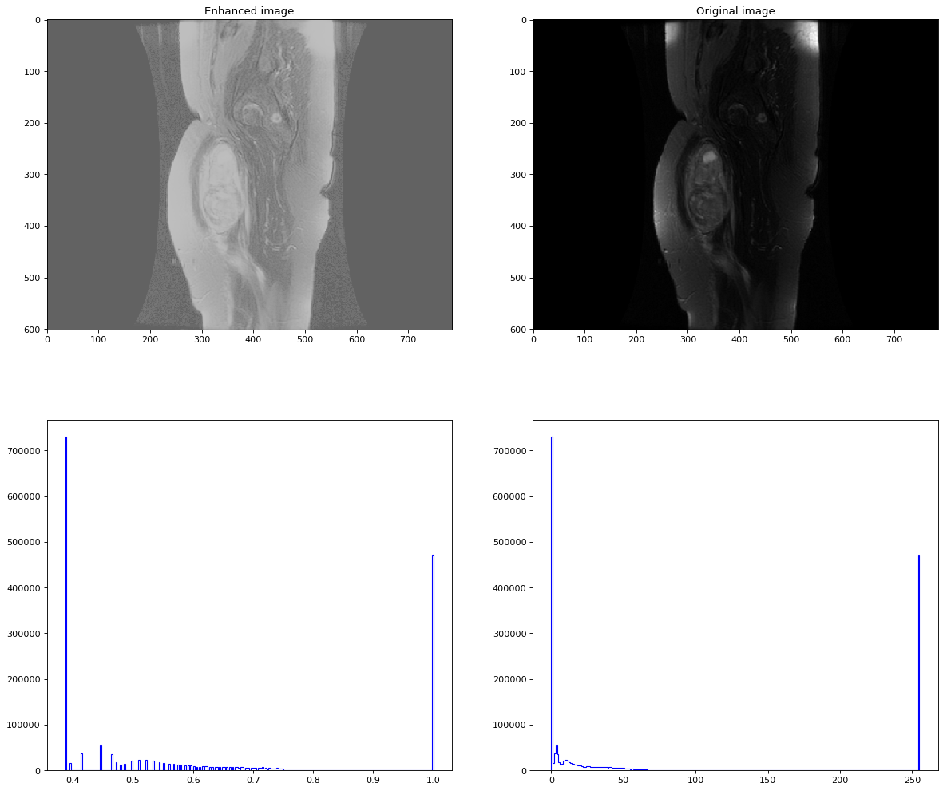
2. Histogram Equalization
The goal of histogram equalization is to distribute the grey levels within an image so that every grey level is equally likely to occur. Histogram equalization will increase the brightness and contrast of dark and low contrast images. The histogram equalization algorithm has been a conventional image enhancement algorithm for its simplicity and efficiency.
However, it is still causing lose in information, even in the graphs we can see there is no continuity.

Slide 7
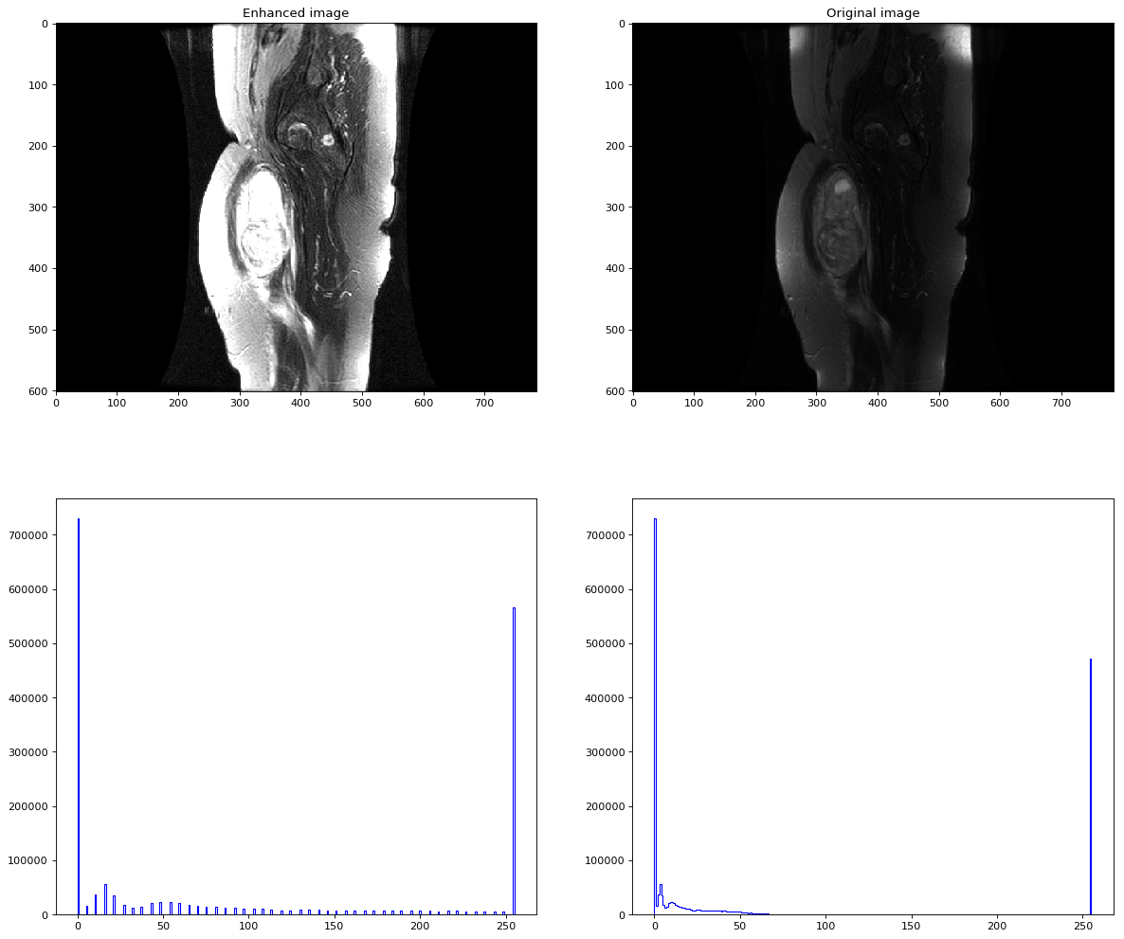
3. Percentile Method
We are using numpy.percentile, to compute the q ^{th} percentile of the data along the specified axis.
Even though image looks better compared to previous imaging techniques, but there is still lose in information.

Slide 8
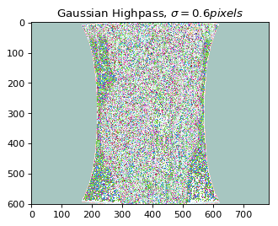
4. Gaussian High-pass Filter
A high-pass filter can be used to make an image appear sharper. These filters emphasize fine details in the image – exactly the opposite of the low-pass filter. High-pass filtering works in exactly the same way as low-pass filtering; it just uses a different convolution kernel, it amplifies the noise.
An over-processed image will look grainy and unnatural, and point sources will have dark donuts around them. So while high-pass filtering can often improve an image by sharpening detail, overdoing it can actually degrade the image quality significantly.

Slide 9
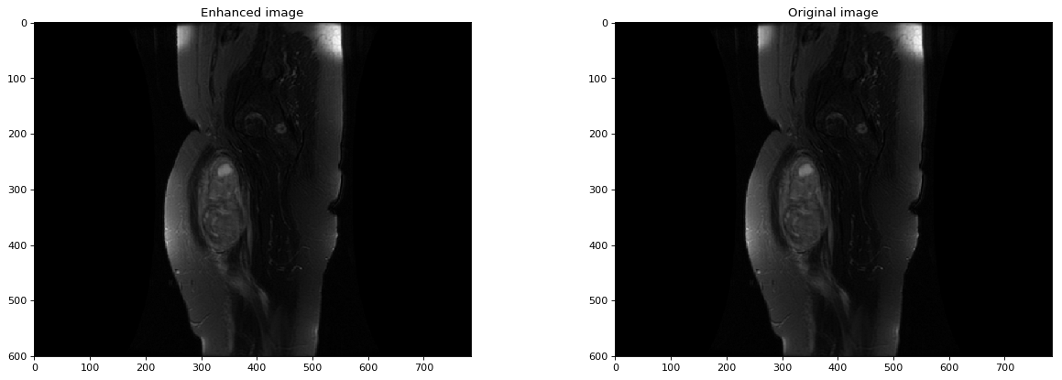
5. Grey Scale Enhancement Technique
Here, we are using “rgb2gray” function to obtain enhanced grey scale image.
This technique is quite efficient.

Slide 10
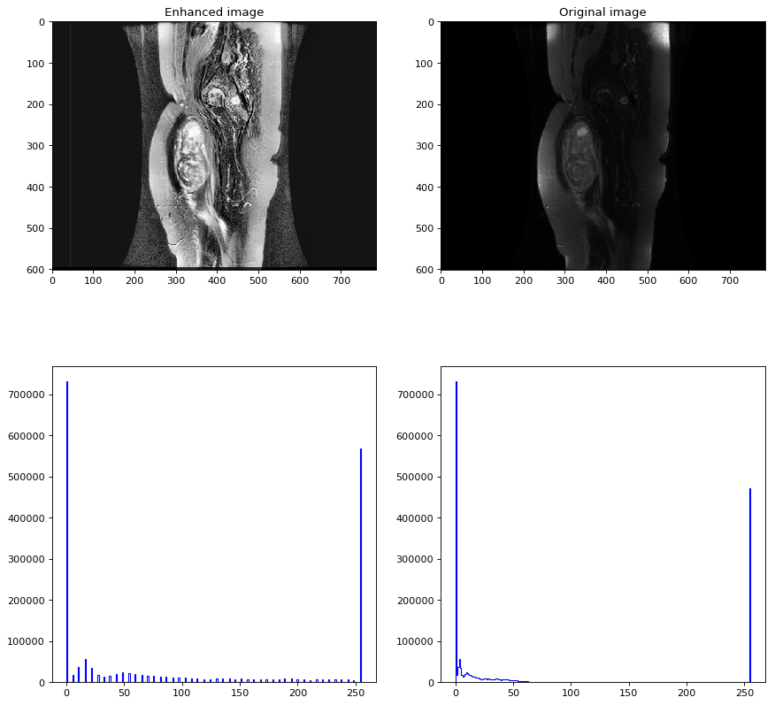
6. Adaptive Histogram Equalization (AHE)
Adaptive histogram equalization (AHE) is a computer image processing technique used to recover contrast in image.
It avoids excessive grey pixel merger and excessive bright local areas of the image. Experiments show that the improved algorithm may effectively improve visual effects under the premise of the same information entropy. It is mainly used in CT image processing.
From the figure, we can clearly see that the image enhancement is much efficient compared to other techniques

Slide 11
Conclusion
This project highlights various image enhancement techniques which can be used particularly for medical image enhancement. Results obtained, both in terms of subjective and objective shows the superiority of Adaptive Histogram Equalization (AHE).
Thank you

